Slide 1
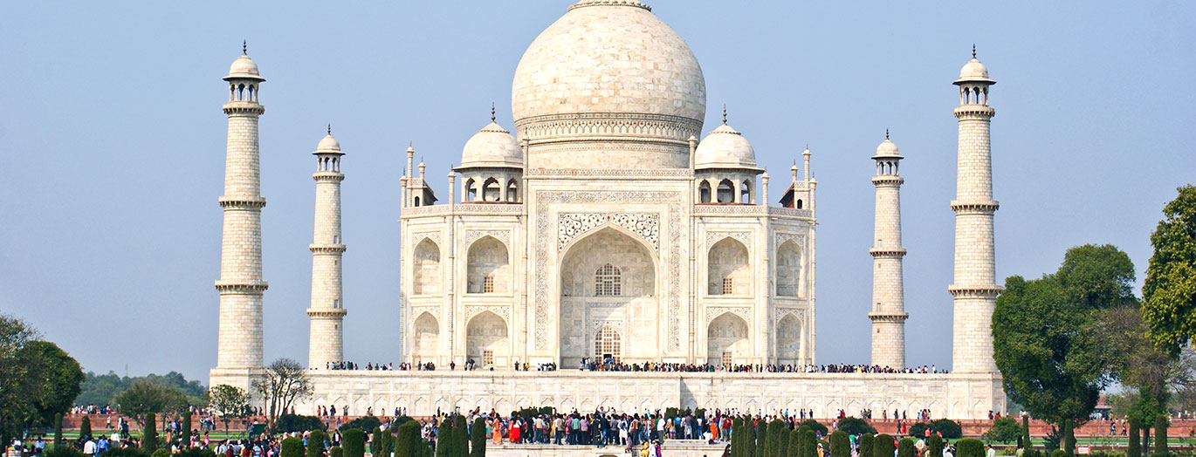
[School Name]
*you can replace this image with the image on your quote*
[Trip Destination], [date]

Slide 2
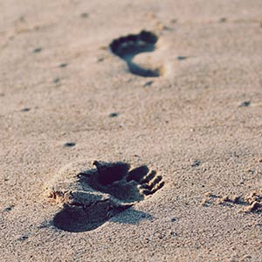
What are we here to talk about?
Where, when and why are we going?
How much and who can go?
What are we going to see and do?
Where are we staying?
Who’s our tour operator?
What happens now?
Anything else we should know?
Any questions?

Slide 3
Where, when and why are we going?
Where?
[Destination]
When?
[Dates, departure and return times?]
Why?
[Aim of the tour]

Slide 4
How much and who can go?
How much?
Who can go?
£…
This includes:
Return transportation by air/coach
… nights’ full-board/half-board/room only accommodation
Travel insurance
Visits and entrance fees?
Group passport?
Itinerary planning service
E.g. ‘This trip is open to all GCSE PE students.’

Slide 5
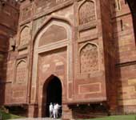
What are we going to see and do?
1 slide per fixture/visit
Use the text and images from your quote destination guide or create your own description

Slide 6
What are we going to see and do?
e.g. Red Fort
The largest of old Delhi's monuments is the Lal Quila or the Red Fort, whose thick red sandstone walls, bulging with turrets and bastions, have withstood the vagaries of time and nature.
Its walls extend upto two kilometres and vary in height from 18 metres on the river side to 33 metres on the city side. Even today the Lal Quila is an eloquent reminder of the glory of the Mughal era and its magnificence simply leaves one awestruck.
It is still a calm haven of peace which helps one to break away from the frantic pace of life outside the walls of the Fort and transports the visitor to another realm of existence.

Slide 7
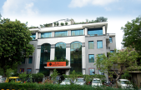
Where are we staying?
Provide details on your accommodation
Use the text and images from your quote and destination guide or create your own description

Slide 8
Where are we staying?
e.g. Hotel Africa Avenue
This popular, modern hotel offers ele.g.ant, tranquil accommodation with excellent facilities, making this the ideal base from which to explore New Delhi.
Close to many of the city's key historical sites and just 15 minutes from Delhi (Indira Ghandi International) Airport, this hotel offers free Wi-Fi throughout. There is also a lovely restaurant serving both Indian and international cuisine.
All guestrooms feature an en-suite bathroom and air-conditioning, as well as a flat screen TV. Reception provides a 24-hour service.

Slide 9
Where are we staying?
e.g. Hotel Africa Avenue
Location
This hotel makes a fantastic base from which to explore New Delhi. Access is very easy, thanks to the hotel's location just 15 minutes' drive from Delhi Airport and 20 minutes' drive from New Delhi Railway Station.
The hotel is also close to a number of the city's main commercial areas, such as Connaught Place.
The hotel is also within easy reach of many of the city's historical and cultural attractions, including the Qutub Minar.

Slide 10
Who’s our tour operator?
Over 35 years of experience
Halsbury Travel has been arranging school trips abroad for more than 35 years. The company was founded in 1986 by a former teacher.
He created Halsbury Travel to make the process easier for teachers, so that more young people would have the opportunity to experience learning outside the classroom. And Halsbury still have many former teachers in their staff, helping them to fully understand the needs of school groups.

Slide 11
Financially protected
You’re financially protected by Halsbury’s ABTA bond and all the company’s flight packages are ATOL protected too.
ABTA
ABTA is the leading association of travel agents and tour operators in the UK. ABTA provides protection for travellers in the event that their travel agent or tour operator ceases trading. If this happens before travel, ABTA ensures a full refund is provided. If this happens while abroad, ABTA ensures that the trip can continue as planned.

Slide 12
Financially protected
ATOL
ATOL stands for Air Travel Organiser’s Licence and is a financial protection scheme that specifically covers air package holidays sold by tour operators and other travel businesses. If a company that holds an ATOL fails, the scheme ensures that minimal disruption is caused to passengers already abroad and those who haven’t travelled yet receive a full refund.

Slide 13
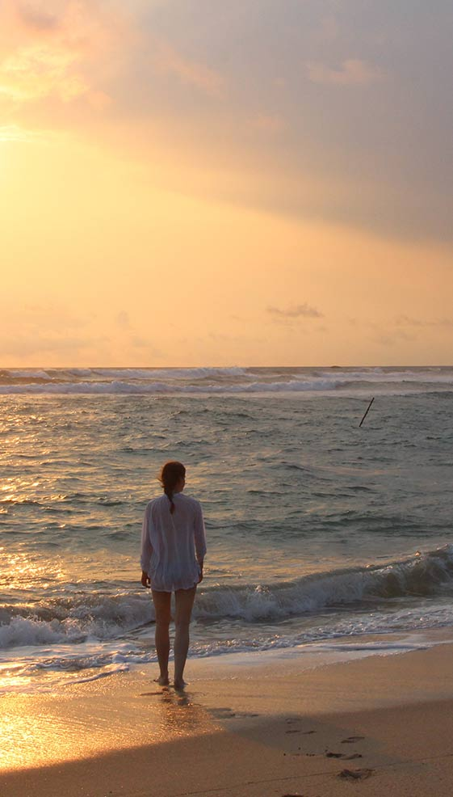
Who’s our tour operator?
Committed to prioritising health and safety
Halsbury is also an Assured Member of the School Travel Forum, which demonstrates the company’s commitment to prioritising the health and safety of its groups.
And Halsbury has been awarded the Learning Outside the Classroom Quality Badge, which demonstrates the company’s commitment to offering activities that are safe and beneficial to learning.

Slide 14
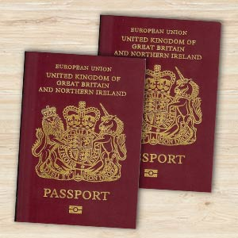
Anything else we should know?
Relevant info on passport validity, visas etc.
Info on EHIC – free via the NHS website
Inform them that they will need to make you aware of any medical conditions/special dietary requirements that their child has as soon as possible
How much spending money should my child bring and in what currency?

Slide 15
Anything else we should know?
What clothing/equipment will I need to provide my child with?
A small backpack
Basic toiletries, i.e. shampoo and soap, toothbrush and toothpaste
Towel (if not provided by accommodation)
Sensible shoes
Raincoat (depending on destination)
Sun lotion (depending on destination)
Spare t-shirt, jumper, socks, underwear, coat
Camera (please note that this will be the student’s responsibility, please read the insurance documents carefully)

Slide 16
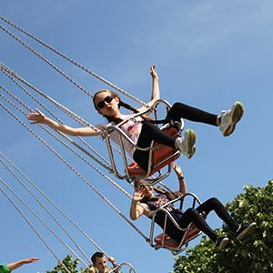
What happens now?
To secure your child’s place on the trip, please return the signed permission slip with the initial deposit payment of £… by ….
The balance of £… must be paid by …
Please make sure that your child’s passport and visa (if applicable) meet all requirements. If in any doubt at all, please contact us as soon as possible.

Slide 17
Any Questions?
*Invite parents to ask questions. If you’re not sure of the answer, please feel free to contact us. Of course, we can also attend parents’ evenings to support you, please let us know in advance if you require this.*

